Slide 1
C Sharp
Presentation

Slide 2
Index
Data Types
Operators
Type Casting
Conditional Statements
Control Statements
Pass by Value, Reference, Out
Passing Array to Method
Arrays
Collections
Nullables.

Slide 3
Data Types
Data Types are used to define the type of data and size of data. It tells the program which type of data enter into the program.
Data types in C# are classified into two types:-
1.Value Types
- PredefinedTypes (string, int , double , float, chat)
-User Defined(enum)
2.Reference Types
-Predefined Types(Object,String)
-User Defined(Arrays)

Slide 4
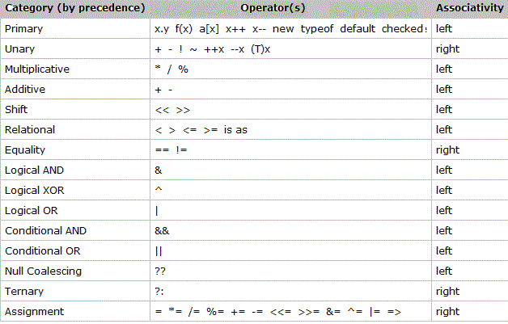
Operators: Operators allow us to perform different kinds of operations on operands. In C#, operators Can be categorized based upon their different functionality :
1.Additional Operators
2.Assignment Operator
3.Ternary Operator
4.Conditional Operator
5.Logical Operator
6.Relational Operator
7.Unary Operator

Slide 5
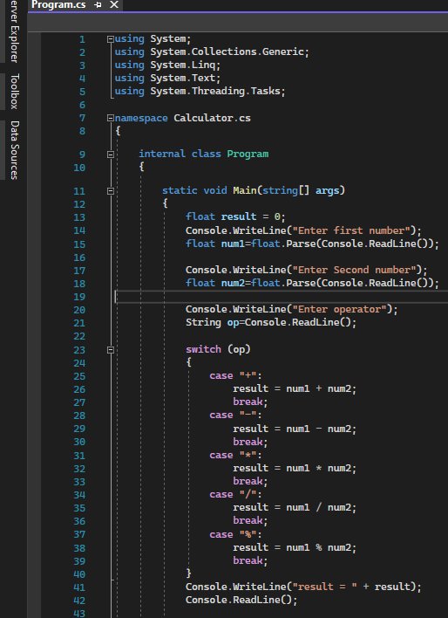
Calculator Program

Slide 6
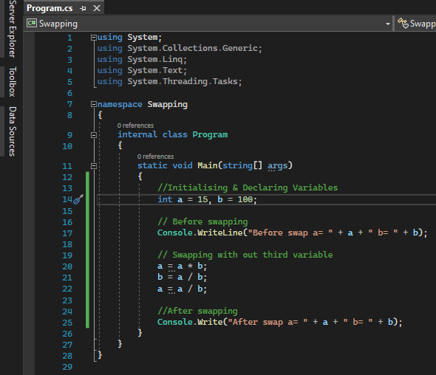
Swapping of Two Numbers
Without using any third variable

Slide 7
Type Casting
The meaning of Type Casting is to change one data type into another data type.
Type Casting should be done in two ways:-
Implicit Type Conversion:- Implicit type conversion takes place between smaller to larger integral types but not vice-versa or between derived class and base class.

Slide 8
Explicit type Conversion
Explicit Type Conversion:- In Explicit type conversion, we explicitly convert one type to Another. Generally, larger types like double(having large memory size)are converted into Smaller types like int(having small memory size).

Slide 9
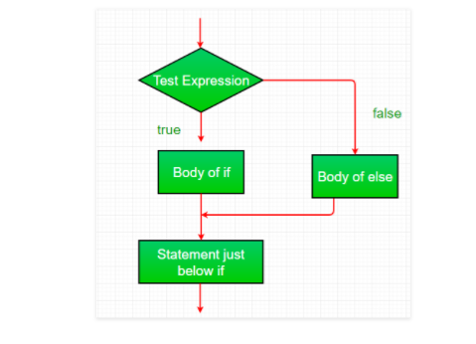
Conditional Statements
Conditional Statements are used to transfer execution control to the correct path based on comparison result.
If else, switch case are used for comparing value.
If else:-The if… else construct is used for determining the flow of program based on returning expression value. It evaluates the comparison operator and based on value executes the statements.

Slide 10
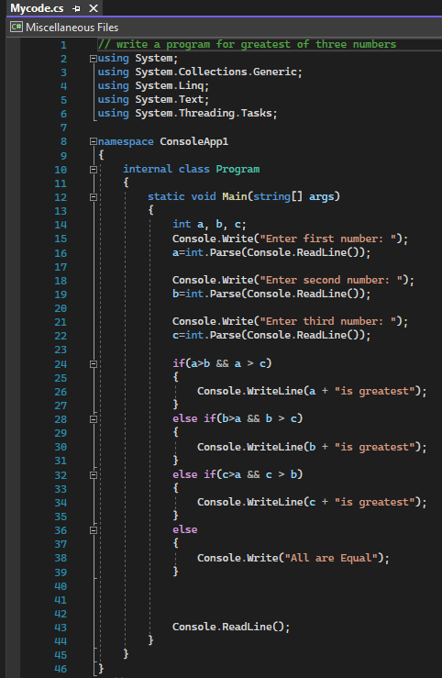

Greatest of Three Numbers(Using ifelse)

Slide 11

Switch case:-It is used when there is multiple if condition in a program. It also includes a default value in Default statements. If no any case Matches then Default statements executes and run the code.

Slide 12
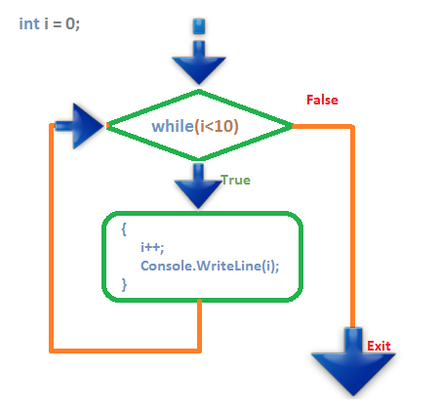
Control Statements
Control Statements:-The loop constructs are used to execute a block of code until the condition becomes expired.
The while loop is one of the important looping constructs, that is being widely used in C sharp programming language. To understand the concept of while loop, consider the following diagram.

Slide 13
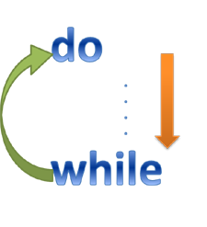
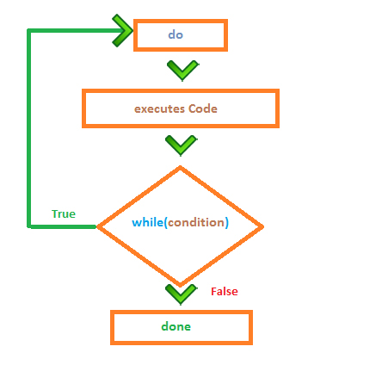
.
Do-While:-do while loop treats same as while loop but only differences between them is that, do while executes at least one time. The code executes first then check for specified loop condition.

Slide 14

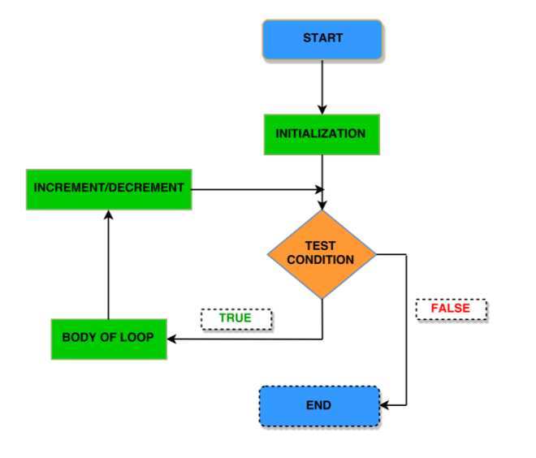
For
for loop is another powerful loop construct in C#. It is powerful and easy to use. for loop includes all three characteristics as initialization, termination and increment/decrement in a single line.
Syntax:-for (initialization; termination; increment / decrement) ;

Slide 15
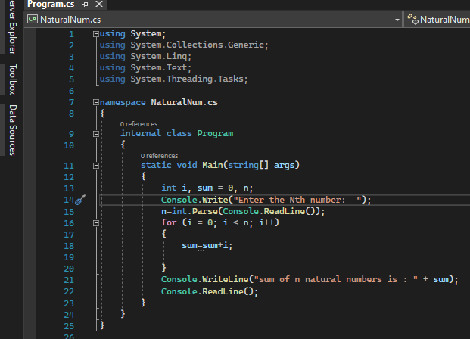

Example of For Loop

Slide 16

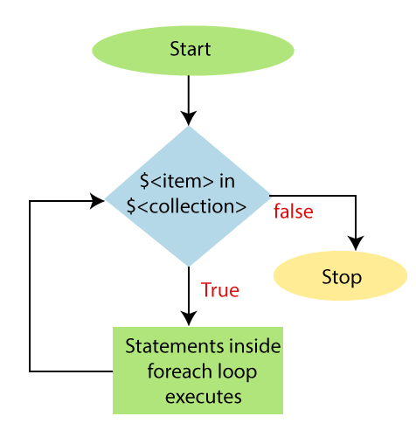
For Each Loop
foreach loop is a different kind of looping constructs in C# programming that doesn’t includes initialization, termination and increment/decrement characteristics. It uses collection to take value one by one and then processes them.

Slide 17
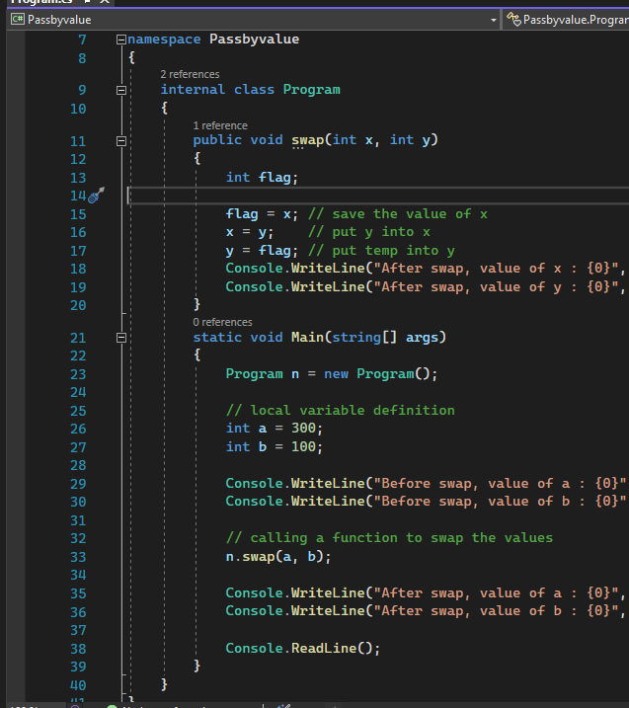
Pass by value
In C#, value-type parameters are that pass a copy of original value to the function rather than reference. It does not modify the original value. A change made in passed value does not alter the actual value.

Slide 18
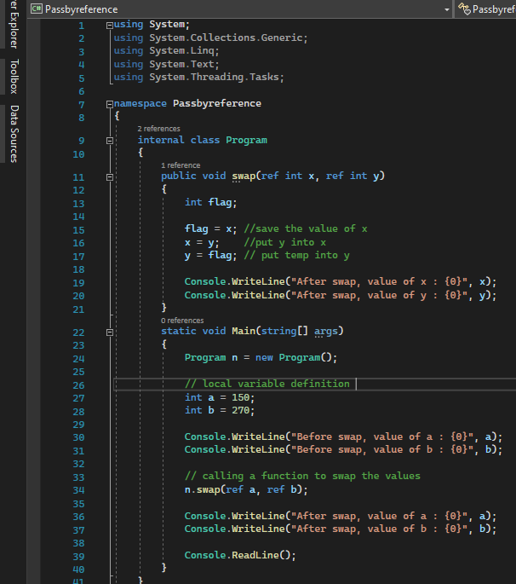
Pass by Reference
C# provides a ref keyword to pass argument as reference-type. It passes reference of arguments to the function rather than copy of original value. The changes in passed values are permanent and modify the original variable value.

Slide 19
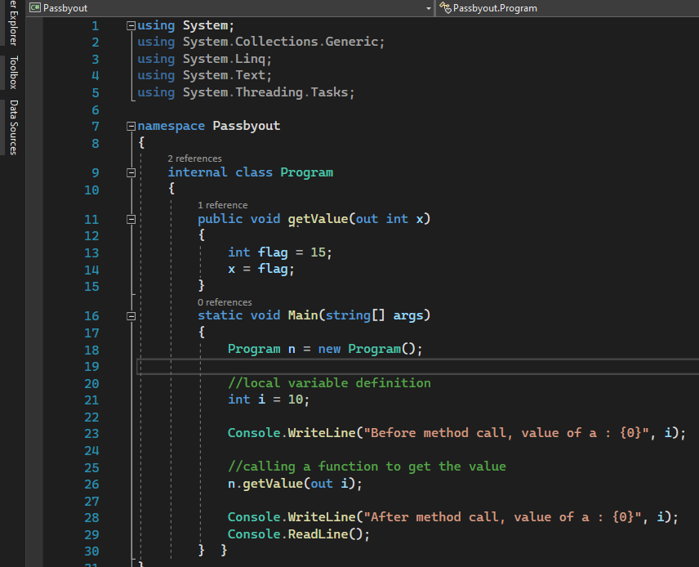
Pass by Out
C# provides out keyword to pass arguments as out-type. It is like reference-type, except that it does not require variable to initialize before passing. We must use out keyword to pass argument as out-type. It is useful when we want a function to return multiple values.

Slide 20
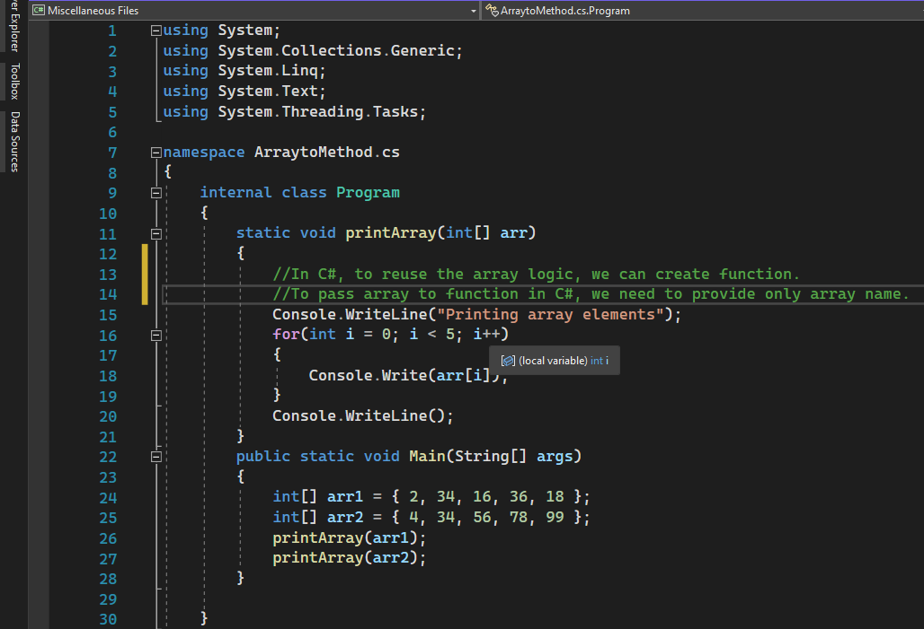
Passing Array to Method
Printing Array Elements
2
34
16
36
18
Printing Array Elements
4
34
56
78
99

Slide 21
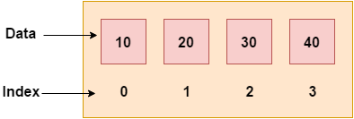
Arrays
Like other programming languages, array in C# is a group of similar types of elements that have contiguous memory location. In C#, array is an object of base type System.Array. In C#, array index starts from 0. We can store only fixed set of elements in C# array.
Types of Arrays
1.Single Dimensional Array
Multi Dimensional Array
Jagged Array
Param Arrays

Slide 22
Single and Multi Dimensional Array
The one dimensional array or single dimensional array in C# is the simplest type of array that contains only one row for storing data. It has single set of square bracket (“[]”).
Syntax:-string[] Books = new string[5];
The multi-dimensional array in C# is such type of array that contains more than one row to store data on it. The multi-dimensional array is also known as a rectangular array in c sharp because it has the same length of each row. It can be a two-dimensional array or three-dimensional array or more. It contains more than one comma (,) within single rectangular brackets (“[ , , ,]”).

Slide 23
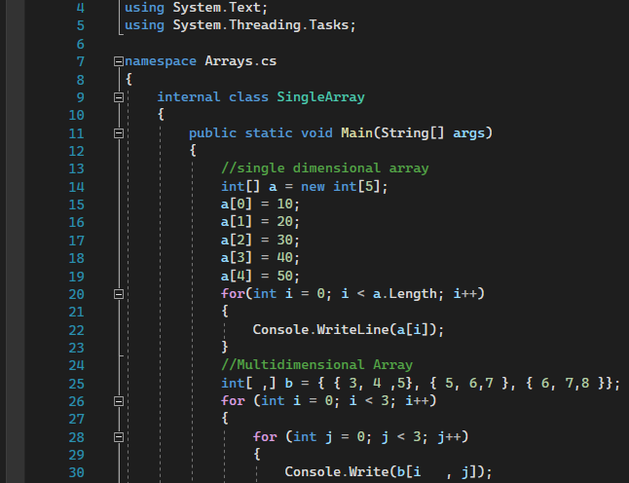
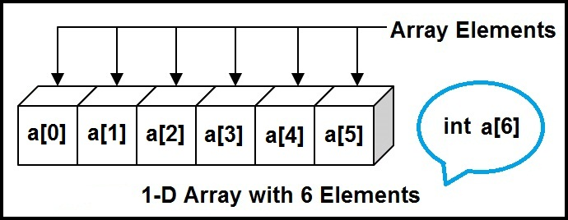
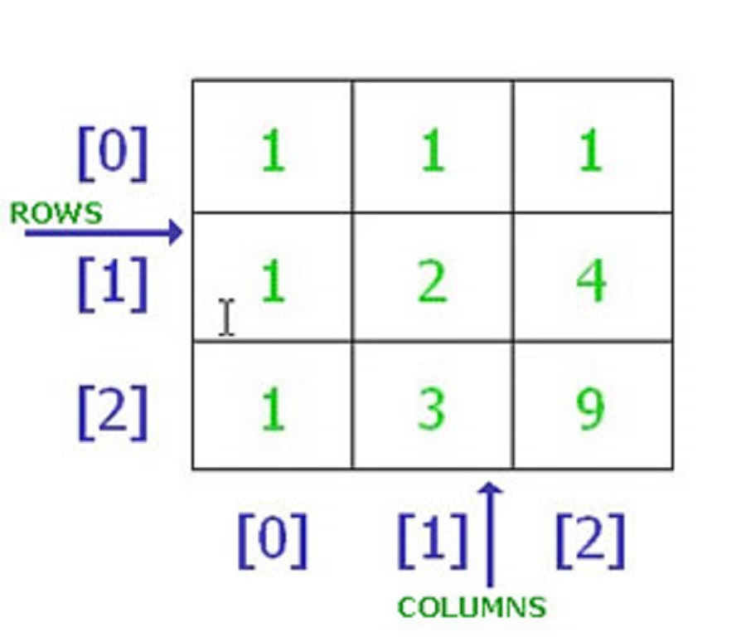
Example of 1D&2D Array

Slide 24
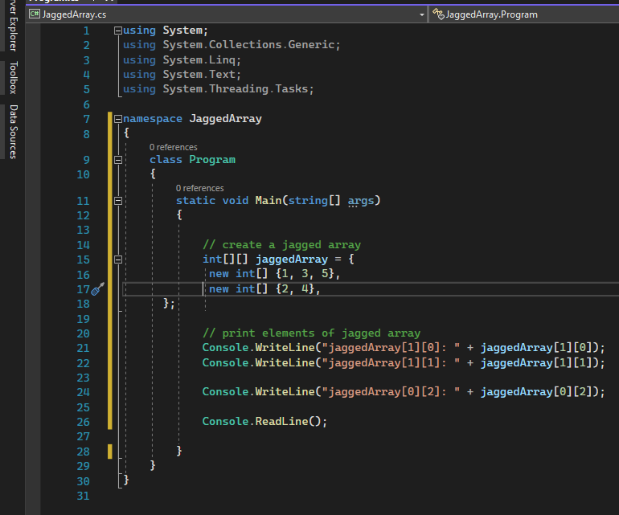
Jagged Arrays
In C#, jagged array is also known as "array of arrays" because its elements are arrays. The element size of jagged array can be different.
Syntax:-int[][] arr = new int[3][]{
new int[] { 11, 21, 56, 78 },
new int[] { 2, 5, 6, 7, 98, 5 },
new int[] { 2, 5 }
};

Slide 25
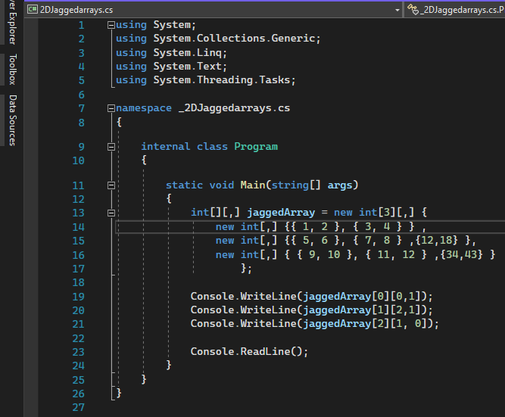
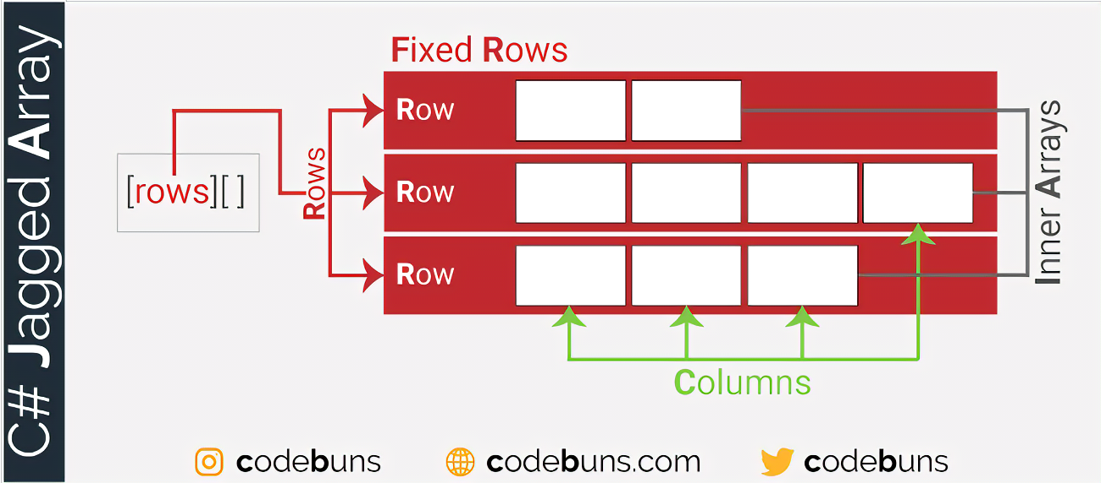
2D Jagged Array

Slide 26
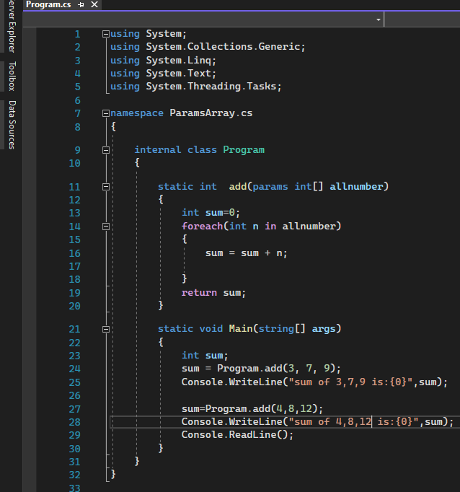
Params Array
In C#, params is a keyword which is used to specify a parameter that takes variable number of arguments. It is useful when we don't know the number of arguments prior. Only one params keyword is allowed and no additional parameter is permitted after params keyword in a function declaration.

Slide 27

Collections
In C#, collection represents group of objects. By the help of collections, we can perform various operations on objects such as
store object
update object
delete object
retrieve object
search object, and
sort object
In sort, all the data structure work can be performed by C# collections.
We can store objects in array or collection. Collection has advantage over array. Array has size limit but objects stored in collection can grow or shrink dynamically.

Slide 28
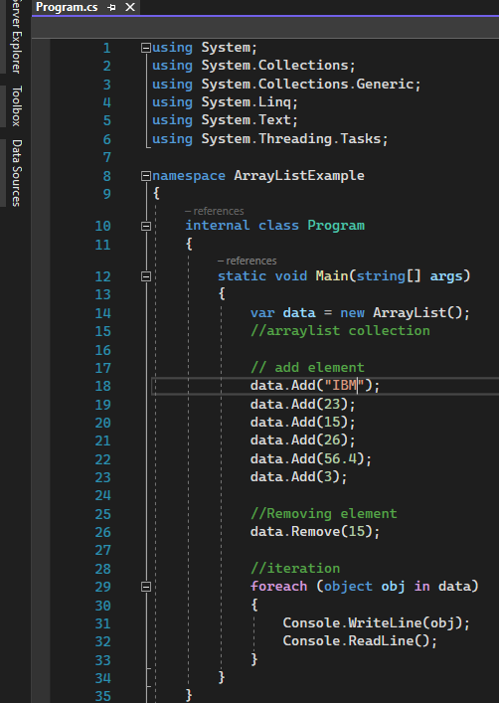
Array List
Array List:- In C# Array list is a non-generic collection of objects whose size increases dynamically .It is the same as Array except that its size increases dynamically
An array list can be used to add unknown data where you don’t know the types and the size of the data.
CREATE AN ARRAYLIST:-
The Array List class included in the System.Collections namespace, Create an object of the Array List using the new Keyword.

Slide 29
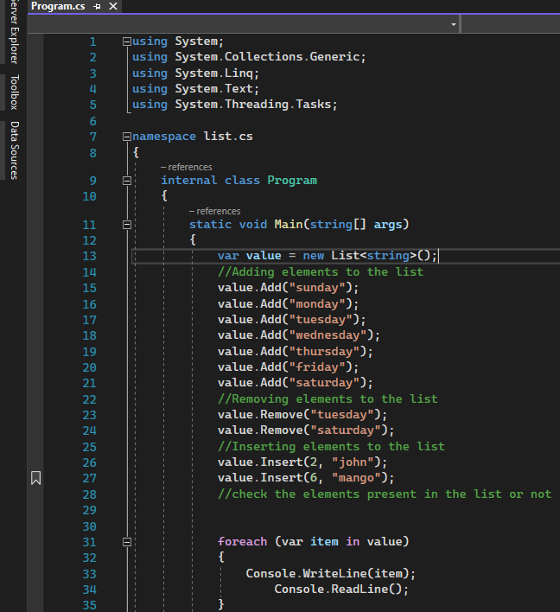
List
The List<T> is a collection of strongly typed objects that can be accessed by index and having methods for Sorting, Searching, and modifying list. It is the generic version of the Array List that comes under System.Collection.Generic namespace.
CREATING A LIST:-The List<T> is a generic collection, so you need to specify a type parameter for the type of data it can store.

Slide 30
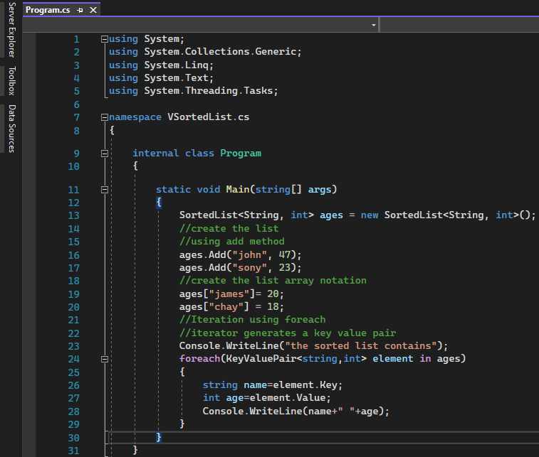
Sorted List
The SortedList<Tkey, Tvalue>, and Sorted List are collection classes that can store key-value pairs that are sorted by the keys based on the associated Icomparer implementation.
C# supports generic and non-generic SortedList. It is recommended to use generic SortedList<Tkey, Tvalue> because it performs faster and less error-prone than the non-generic SortedList.

Slide 31
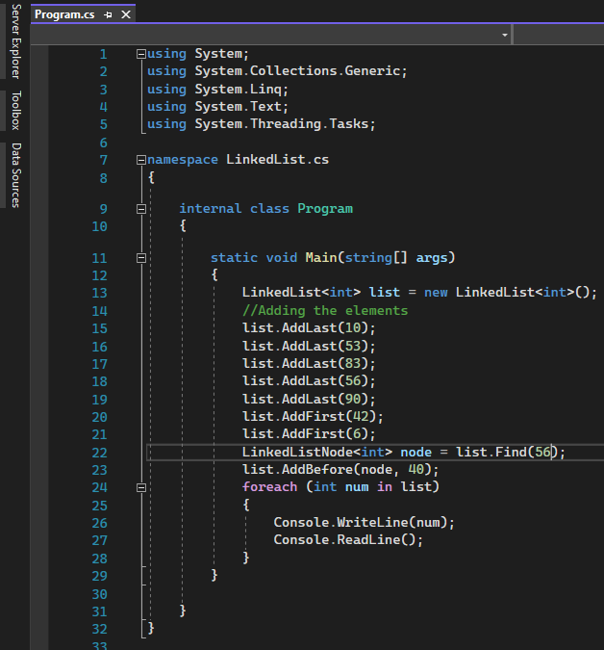
Linked List
C# LinkedList<T> class uses the concept of linked list. It allows us to insert and delete elements fastly. It can have duplicate elements. It is found in System.Collections.Generic namespace.
It allows us to add and remove element at before or last index.

Slide 32
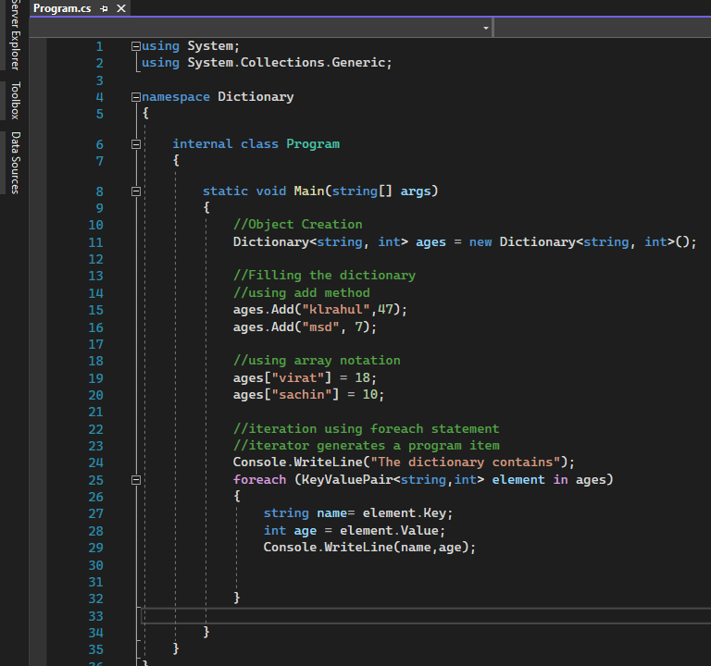
Dictionary
The Dictionary<Tkey, Tvalue> is a generic collection that stores key-value pairs in no particular order.
CREATING AN DICTIONARY:-You can create the Dictionary<Tkey, Tvalue> object by passing the type of keys and values it can store

Slide 33
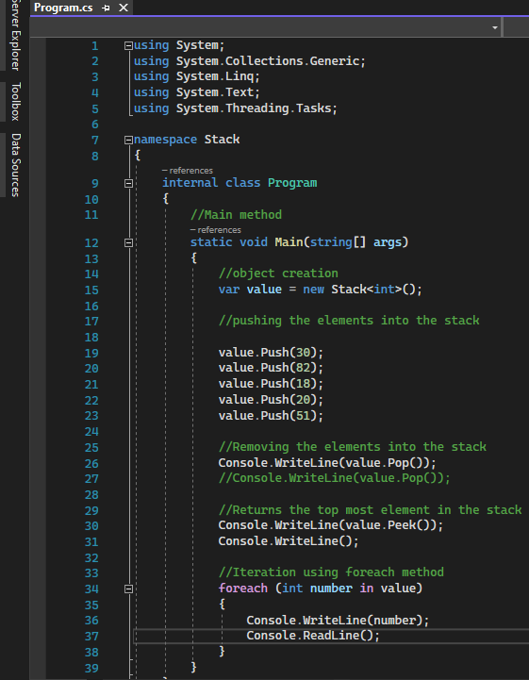
Stack
Stack is a special type of collection that stores elements in LIFO style(Last in First out) . C# includes the generic Stack<T> and non-generic stack collection classes. It is recommended to use the generic stack<T> collection.
Stack is useful to store temporary data in LIFO style, and you might want to delete an element after retrieving its value.

Slide 34
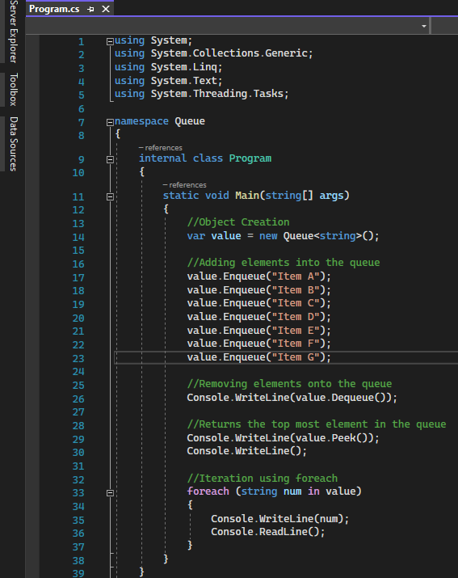
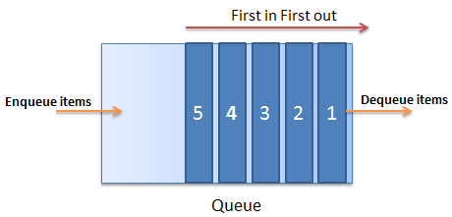
Queue
Queue is a special type of collection that stores the elements in FIFO style(First in First out), exactly opposite of the Stack<T> collection. It contains the elements in the order they were Added. C# includes generic Queue<T> and non-generic queue collection. It is recommended to use the generic Queue<T> collection

Slide 35
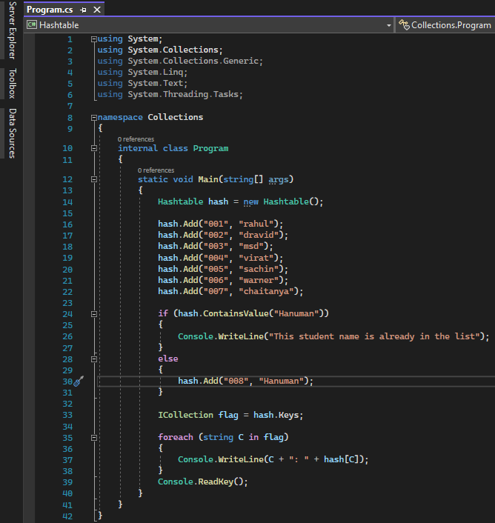
Hash Table
The Hashtable is a non-generic collection that stores key-value pairs, similar to generic Dictionary<Tkey, Tvalue> collection.It optimizes looks up by computing the hash code of each key and stores it in a different bucket internally and then matches the hashcode of the specified key at the time of accessing values.

Slide 36
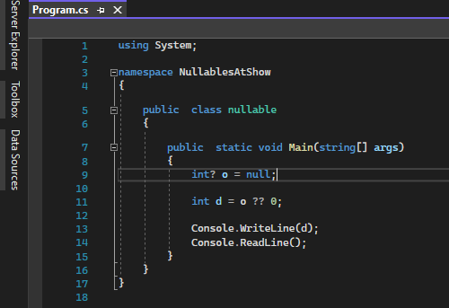
Nullables
In C#, the compiler does not allow you to assign a null value to a variable. So, C# 2.0 provides a special feature to assign a null value to a variable that is known as the Nullable type. The Nullable type allows you to assign a null value to a variable.

Slide 37
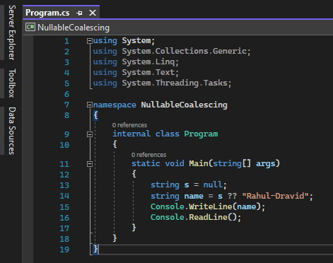
Nullable Coalescing Operator
Null coalescing operator (??) is a C# operator, which is represented by the symbol ?? . It is generally used to set the default value of a variable. It takes two operands, if the left operand is null, then the right operand is returned else the left operand. Its a precise way to say that “If this value is NULL, then use the other value”

Slide 38
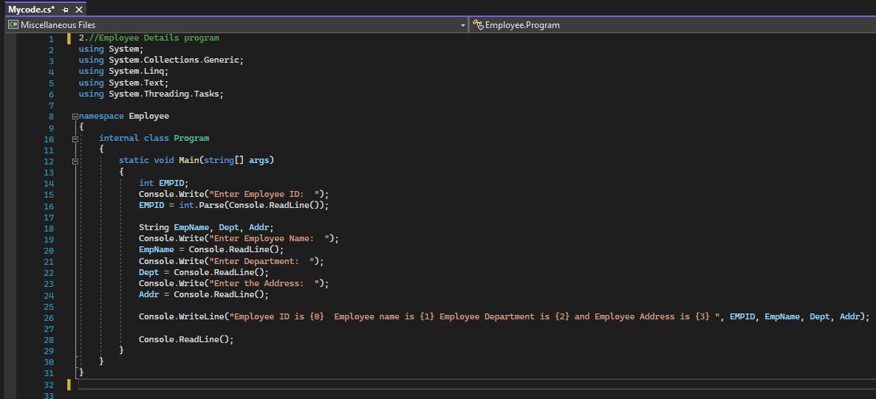
Employee Details Program

